Slide 2
Overview
This presentation will briefly show an overview of the various modules timeware® has to offer. These are:
Setup & Configuration
Personnel
Absence Management
Attendance
Access Control
Attendance Display Panel (ADP)
Reports and Exports
Mobile Worker
To Do List
Employee Self Service (ESS)
GDPR
Working Time Regulations (WTR)
Types of Devices

Slide 3
1. Setup & Configuration
timeware is a SQL based application. SQL 2008 or greater is recommended.
Recommended for large customers that remote desktop be used to maintain speed!
Individual client installations available for smaller customers.
Dedicated server HIGHLY recommended.
Compatible only with Windows 7 or newer.
No software restrictions or packages. When you purchase timeware, you’ve bought the whole package!

Slide 4
2. Personnel Overview
The Personnel module is commonly described as the ‘heart’ of timeware®.
Personnel has been designed to function as a standalone HR system.
Certain features such as period schedules (an employees working pattern) are mandatory for the running of other modules such as Attendance.
Each employee is required to have a Personnel record!

Slide 5
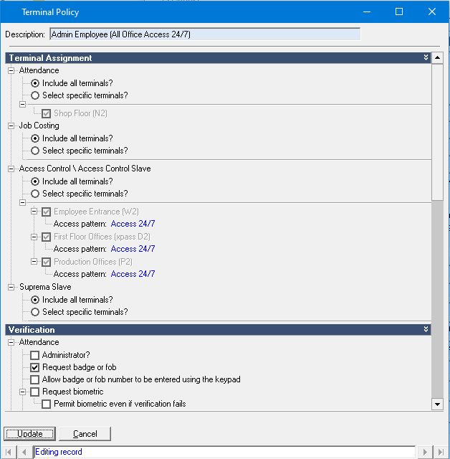
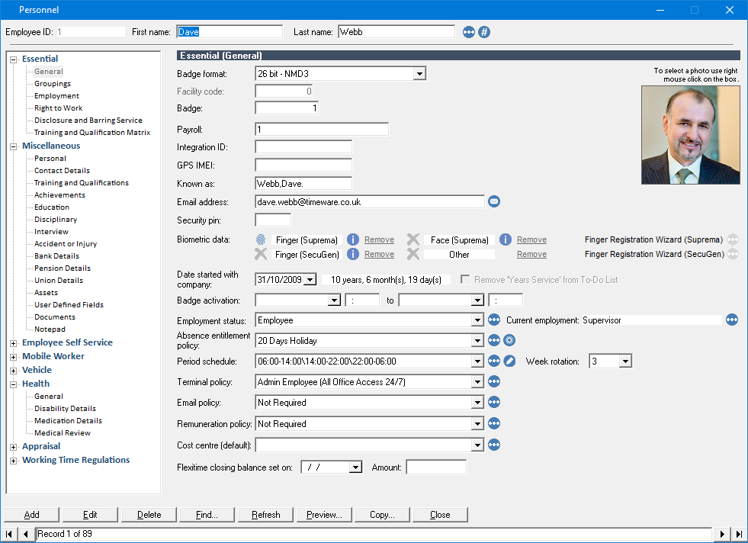
2. Personnel (Essential)
The essential section contains mandatory fields used for the running of other modules.
An example of these mandatory fields is Terminal Policy. This controls which terminals/doors an employee can/cannot use, when they can use it and whether they’ll be using cards or Biometrics.

Slide 6
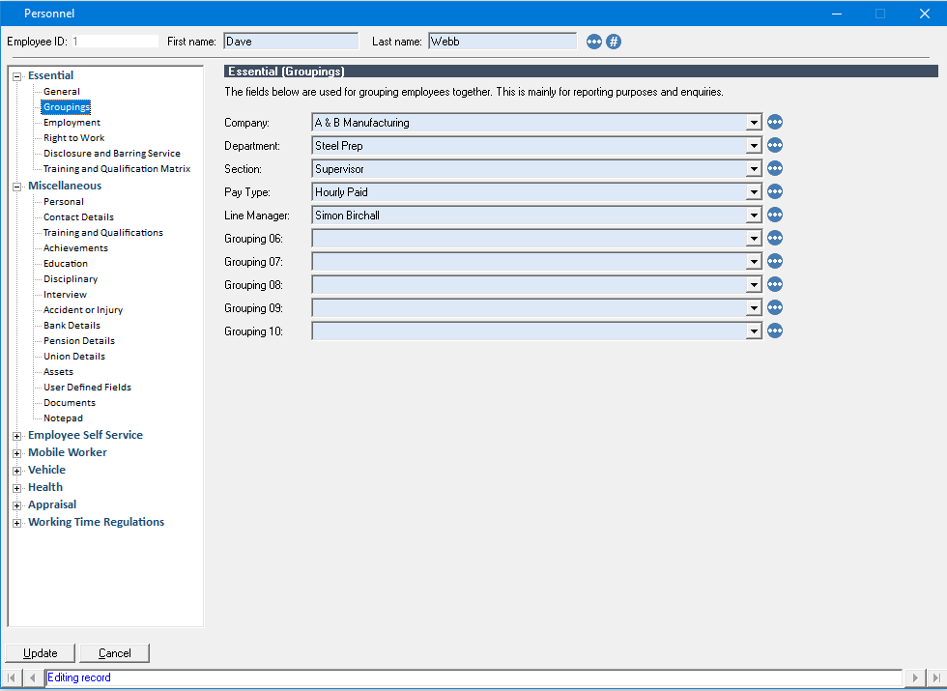
2. Personnel (Groupings)
‘Groupings’ are a way for us to determine where an employee belongs i.e. Location A or Department B.
This is further used to narrow down, for instance, a users timeware® permissions so they can only see employees relevant to them, or to run a report relevant for the user.

Slide 7
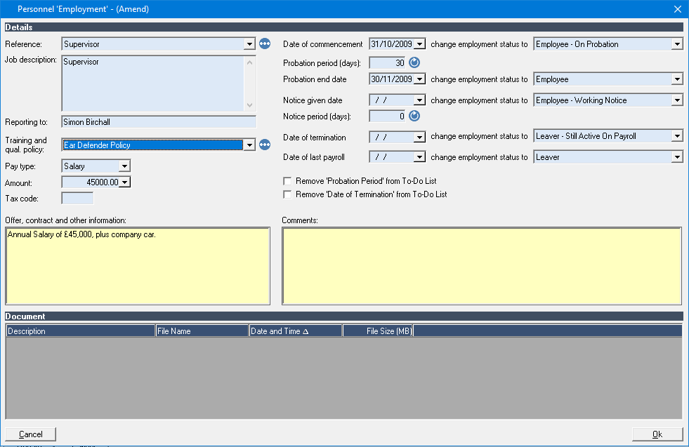
2. Personnel (Employment)
The Employment record is vital as it links to other modules in timeware® such as GDPR or Training and Qualification Matrix.
It will automatically control probationary periods or leave dates so that once those dates come around it will change the employee to the relevant status.

Slide 8
3. Absence Management Overview
The Absence Management module enables the recording of absences such as holidays, sicknesses, bank holidays etc.
Based on ‘Entitlement Policies’, we can use the recorded absences to produce accurate holiday entitlement for employees.

Slide 9
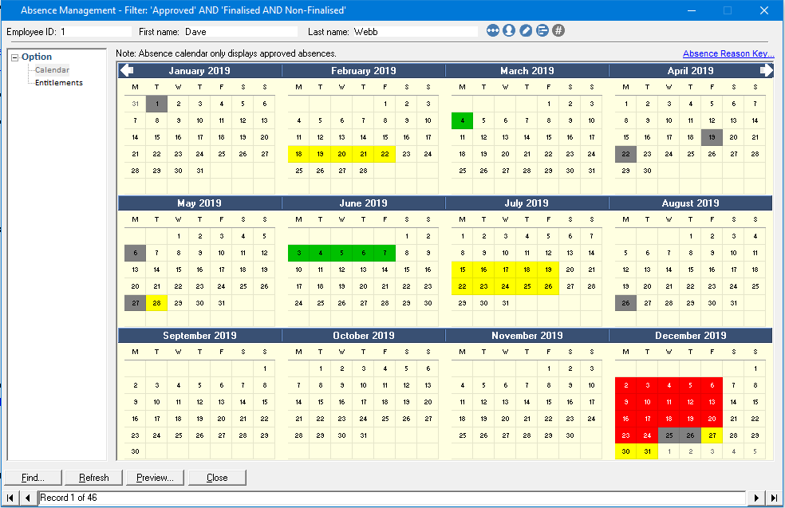
3. Absence Management ‘Calendar’
The main screen of Absence Management comes in the form of an annual calendar (based on the company's entitlement year).
It clearly shows each sickness, holiday or any other absence that may have been created, each with a unique colour.
Absences can be created, edited or deleted from this screen.

Slide 10
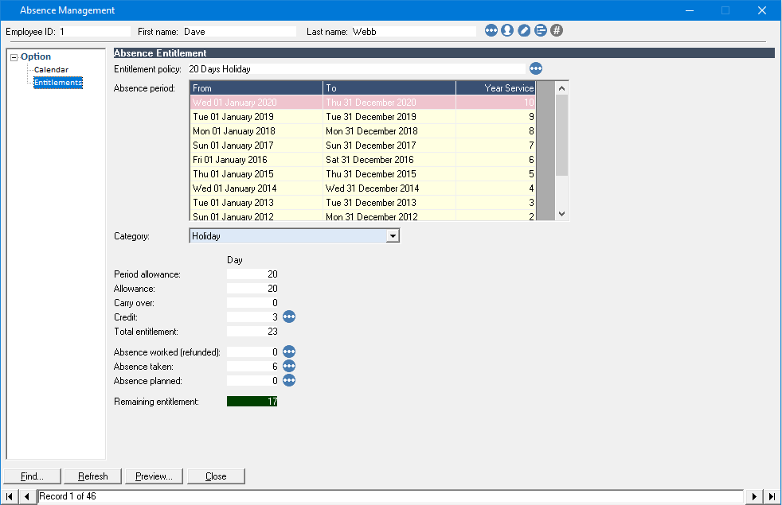
3. Absence Management ‘Entitlements’
The Entitlements shows clearly the holiday entitlement for an employee.
The values are based off the ‘Entitlement Policy’ which determined the number of days they are entitled to.
Credits or debits to entitlements can be actioned via this screen.

Slide 11
4. Attendance Overview
Time and attendance is a core part of our product.
We support a wide range of shift patterns for employees such as ‘4 on 4 off’ rotational patterns or just basic 09.00-17.00. Any pattern you can think of, timeware® attendance can cover.
If a special requirement is needed which our base software cannot cover, such as very unique company rules, we can create scripts to manipulate the data to work like you require.

Slide 12
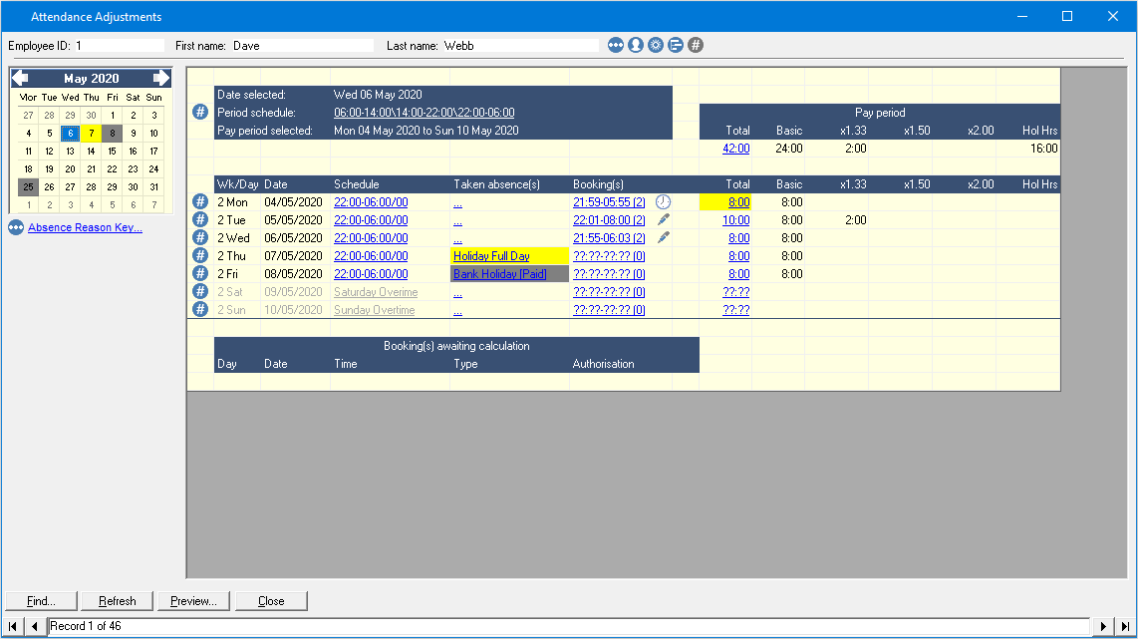
4. Attendance
The Attendance Adjustments module contains information relating to an employee's hours they’ve worked, at what rate, and if they have earned overtime etc.
All data in this section is controlled by ‘schedules’ which in simple terms determine the core hours, rates of pay and overtime rules.

Slide 13
4. Attendance Continued
As standard, we offer ‘overtime authorisation’ which will enable a manager to make the decision on whether the overtime is paid (or not)
All data within attendance is what is used to generate reports etc. which will be covered later.
Absences can also be generated within this module, so you do not need to go back and forth between absence management!
Supports scripting and modification so any requirement can be met.

Slide 14
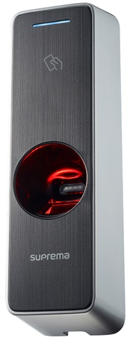
5. Access Control
Our access control module can be used to control doors, barriers and gates.
Access is controlled via the ‘Terminal Policy’ which determines which door somebody can use and when they can use it.
It is compatible with numerous pieces of hardware however we recommend the Suprema W2 readers as our default Access Control reader.

Slide 15
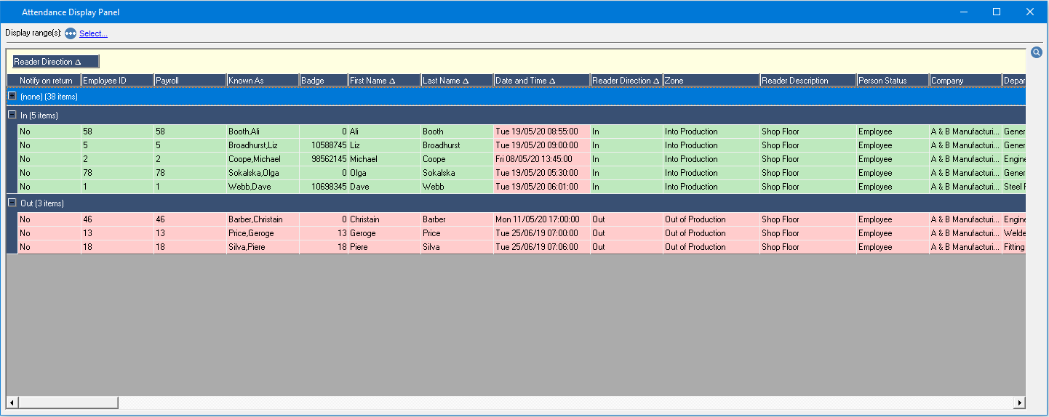
6. Attendance Display Panel (ADP)
The ADP (Attendance Display Panel) is designed to quickly allow you to identify employees who are on site (or off site.)

Slide 16
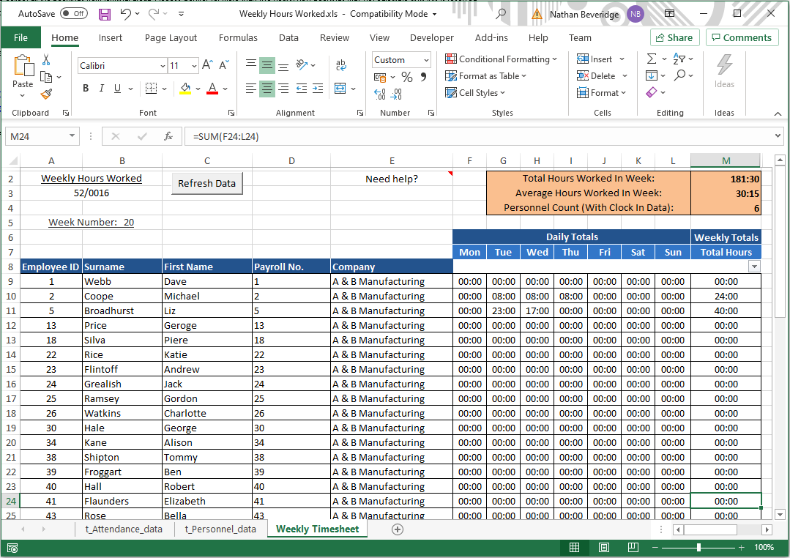
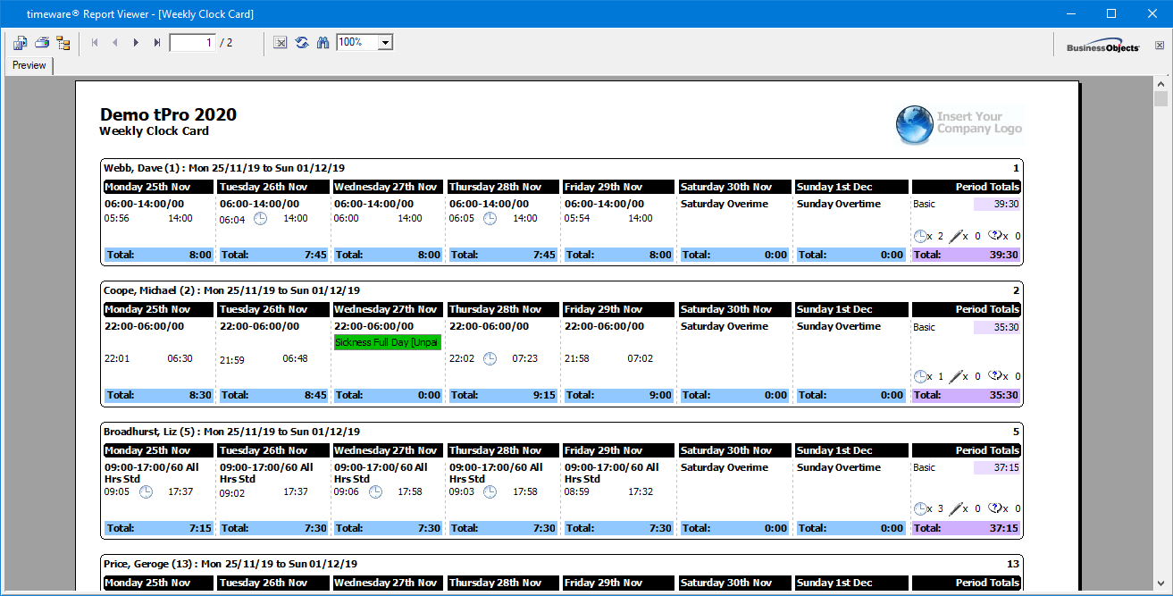
7. Reports & Exports
timeware® contains a full reports and exports system.
It was designed to bring key information or any data you require to you in a reportable or excel exportable format.
Over 200 reports and 30 exports are available.
If a report/export does not exist that you require, they can be written bespoke.

Slide 17
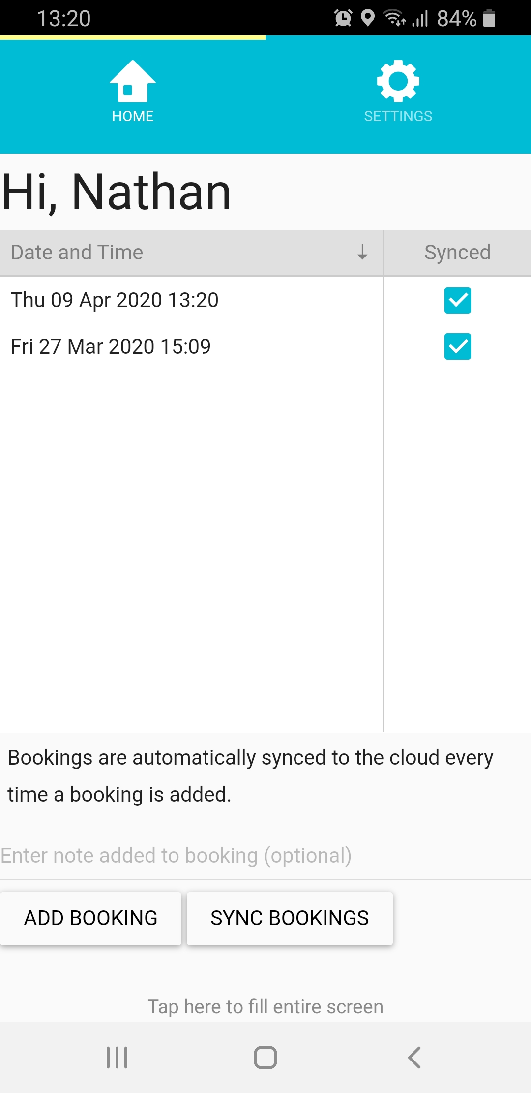
8. Mobile Worker
Not all employees can clock in/out. With those employees in mind, we designed the mobile worker app.
Employees can ‘clock in’ via their mobile phones or other compatible devices and have that act as terminal. GPS location of the clocking is also available!
Ideally targeted at drivers who are out of the office most, if not all the time.

Slide 18
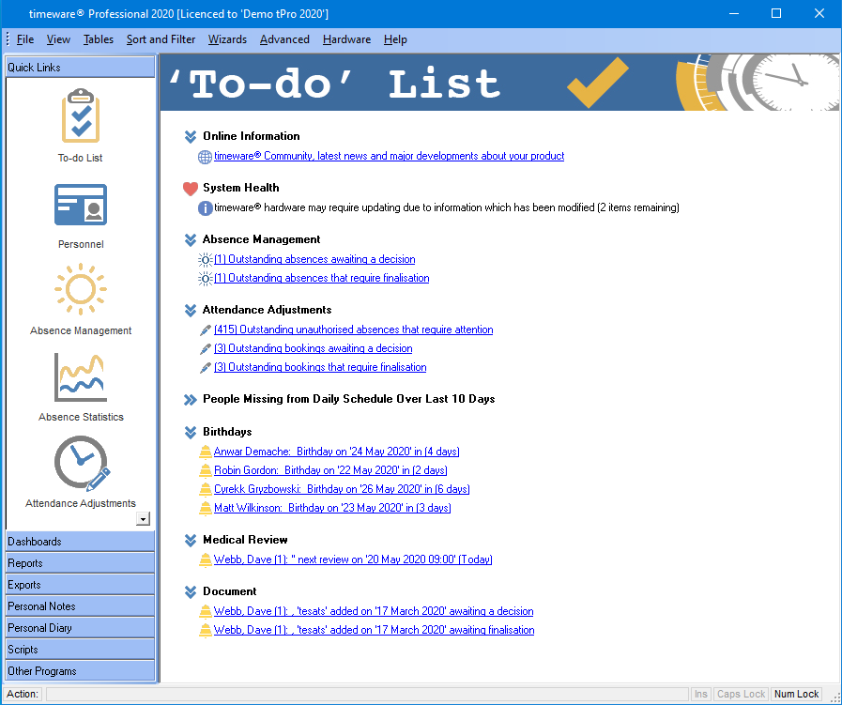
9. ‘To-Do’ List
The ‘To-Do’ list is the first screen you see when you log in to timeware® first thing in a morning.
It’s designed to bring everything you need to know immediately to your attention.
Items that appear on this screen range from overtime that requires authorisation, absences that need approval or any anomalies such as employees forgetting to clock in/out.
It allows you to link through to where anomalies are, so it is quick and concise

Slide 19
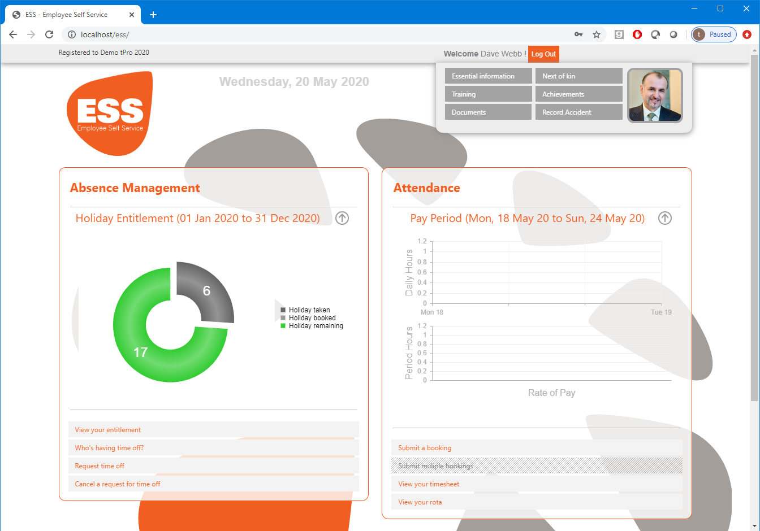
10. Employee Self Service (ESS)
The ESS is an iis hosted webpage which enables an employee to perform several features independent of their manager or HR.
Employees can log in to this via your companies' network, or via the internet (if your IT set it up).
These tasks range from being able to use this to ‘clock in’, right through to requesting a holiday.
Employees can also check their current shift they will be working on in the next X days and view their hours for the previous week.

Slide 20
11. GDPR
Data protection is a vital part of timeware® which is why we developed the GDPR module.
There is no set-in stone rule in terms of a company’s GDPR requirements. We have some defaults, but if rules differ from what we have, we can tailor GDPR to work in whatever way is required.
Rules can range from deleting employees after X years or removing biometric data the moment they become a leaver. You can have as many or as little as possible.
No data is deleted without consent from the timeware® administrator, who just needs to click an accept button.

Slide 21
12. Working Time Regulations (WTR)
Working Time Regulations are set of rules designed to stop the exploitation of employees and are built in-to law.
timeware® contains a full WTR module designed to notify you either before the employee breaches, or after they have breached so corrective measures can be implemented.
The data is exportable in to an excel file for ease of use when checking employees on mass.

Slide 22
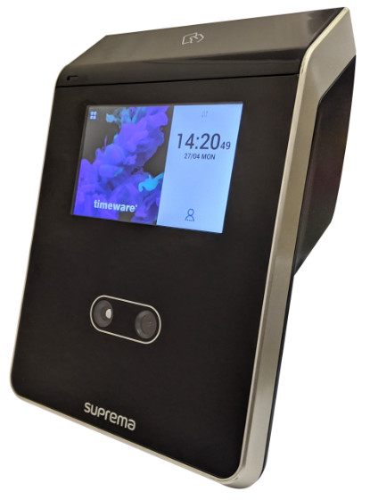
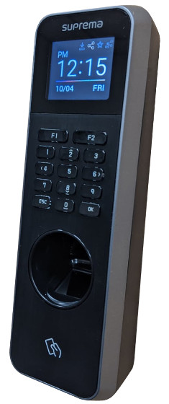
13. Types of Devices
We have an extensive partnership with Suprema who develop a wide range of devices which we use for Access/Attendance purposes.
FaceStation 2
BioLite N2
The FaceStation 2 is Supremas most advanced facial recognition device. We utilize this for Attendance purposes.
The BioLite N2 is a biometric and proximity device that we use for Attendance purposes.

Slide 23
End of Presentation
Thank you for watching.

Slide 24
Head office
timeware® UK Ltd.
3 Fieldhouse Road, Rochdale
OL12 0AD. United Kingdom
General enquiries:
Tel: +44 (0)1706 659368
Web: www.timeware.info
Email: support@timeware.co.uk
Cameroon office
MECLA Company Ltd.
3rd Floor Pharmacie de Logpom Building
P.O. Box 4189 Bonanjo Douala, Cameroon.
General enquiries:
Office: +237 243 12 71 10 (CM)
Mobile: +237 677 20 25 31 (CM)
Mobile: +233 547 68 79 68 (GH)
Email: mesapeglenny@yahoo.com
t2-0418/MECLA: Copyright NMD3 Ltd (2020)
NMD3 acknowledges any logos and/or trademarks used within this document

